Slide 1
Communication Through Food

Slide 2
Why food?
Nothing stopping us understanding a new culture, a different country and the people around us - were they old or new friends, people of the same age or someone older or younger.
Food is a deep rooted part of all cultures and it transfers not only the century old knowledge of cooking and the history of the country but also the modern appliances used, the ideas and innovations connected to it. It allows us to communicate through all senses - sight, smell, hearing, touch and taste. Food creates a sense of community while being prepared or when being eaten. Food is also a form of art - from how it is prepared to how it is served and presented. It is the perfect medium!

Slide 3
What can we do?
Until November 1st, create your own 4 slides in this presentation (per school) about traditional dishes of your country and how to prepare them! Including step by step recipes, pictures, ingredient list, videos - everything necessary for cooking!
Until December 1st - cook! In groups or solo, at home or at school - choose three recipes from different countries (not your own) and cook according to these recipes!
Film the process, take photos and have fun learning more about other cultures and communicating through the art of food!

Slide 4
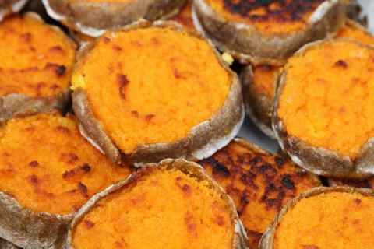
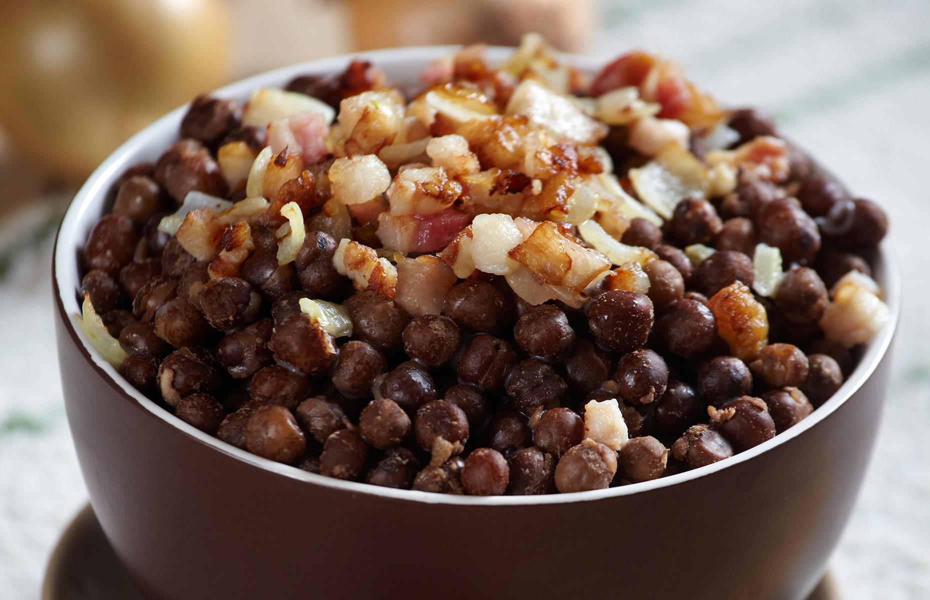
Latvian cuisine
Latvian cuisine typically consists of agricultural products, with meat featuring in most main meal dishes. Fish is commonly consumed due to Latvia's location on the east coast of the Baltic Sea.Latvian cuisine has been influenced by other countries of the Baltic rim. Common ingredients in Latvian recipes are found locally, such as potatoes , wheat, barley, cabbage, onions, eggs and pork.
Some traditional dishes are:
Sklandrausis Grey peas with fried speck

Slide 5
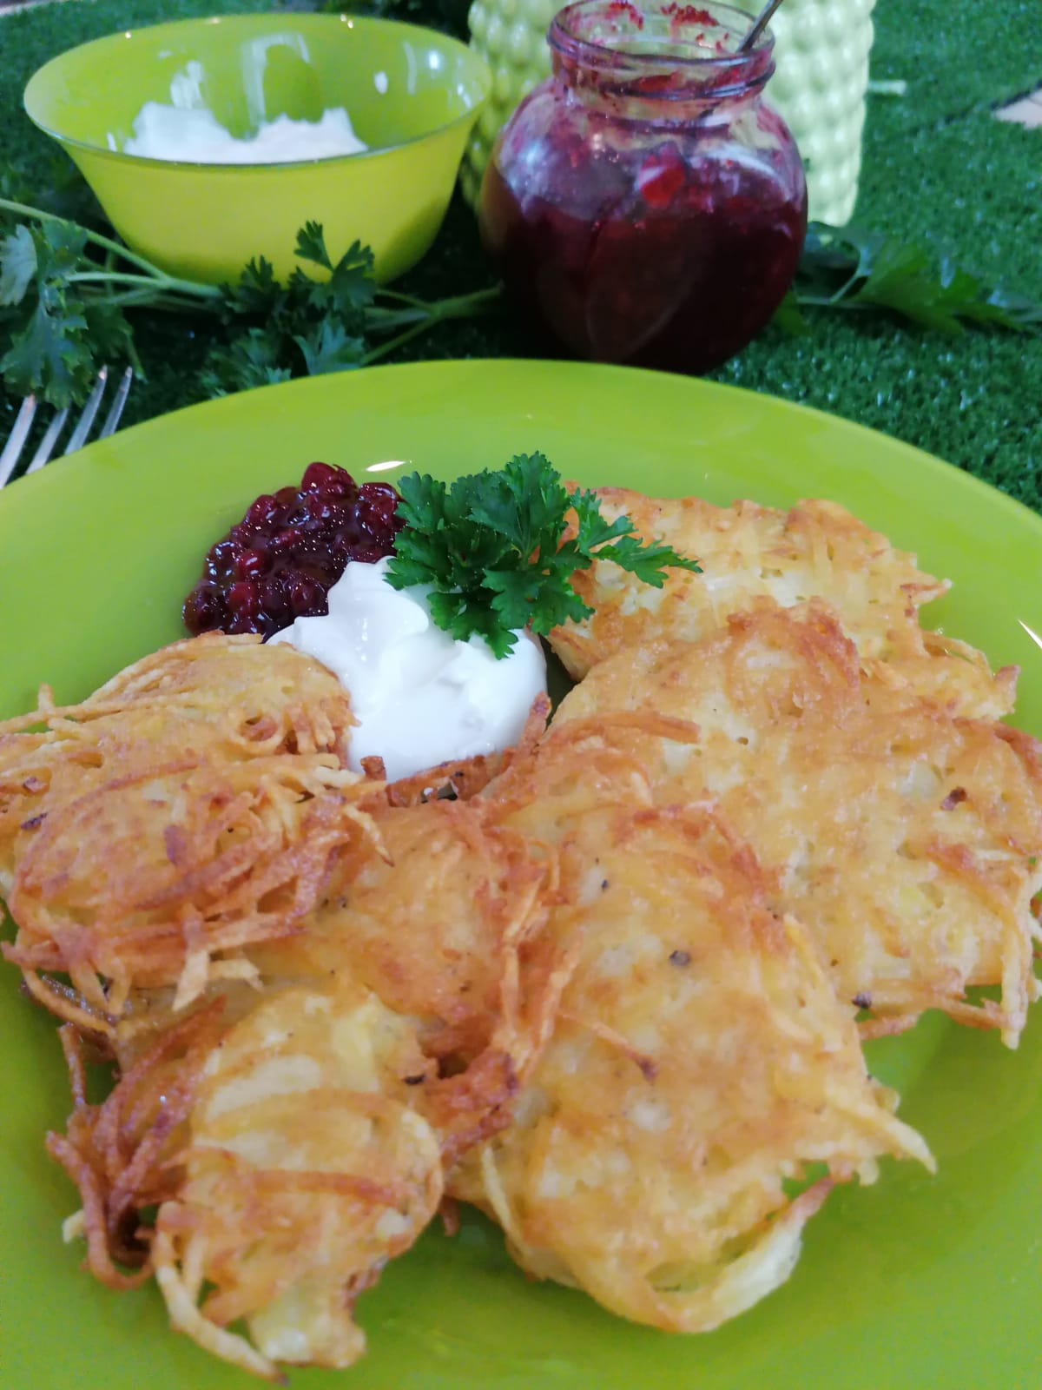
Potato pancakes
Ingredients:
6 potatoes
2 tablespoons all-purpose flour
2 eggs
1 teaspoon salt
Sour cream
How to make it:
The potatoes must be peeled first, then washed.
Then they must be grated.
Once grated, then squeeze the juice in another bowl. The juice should be left to settle the potato starch.
Then add two raw eggs to the mass and add one tablespoon of flour and another tablespoon of potato starch. Also add salt.
Then with a spoon on the pan put a small lump with the mass you created and slightly flatten it.
Then bake it until there is a yellow-brown layer on the bottom and then plaster it on the other side.
Serve warm with sour cream on the side.
Helpful video 1: https://youtu.be/J95n9ie0GyM
Helpful video 2: https://youtu.be/mAF-zeq8NuY

Slide 6
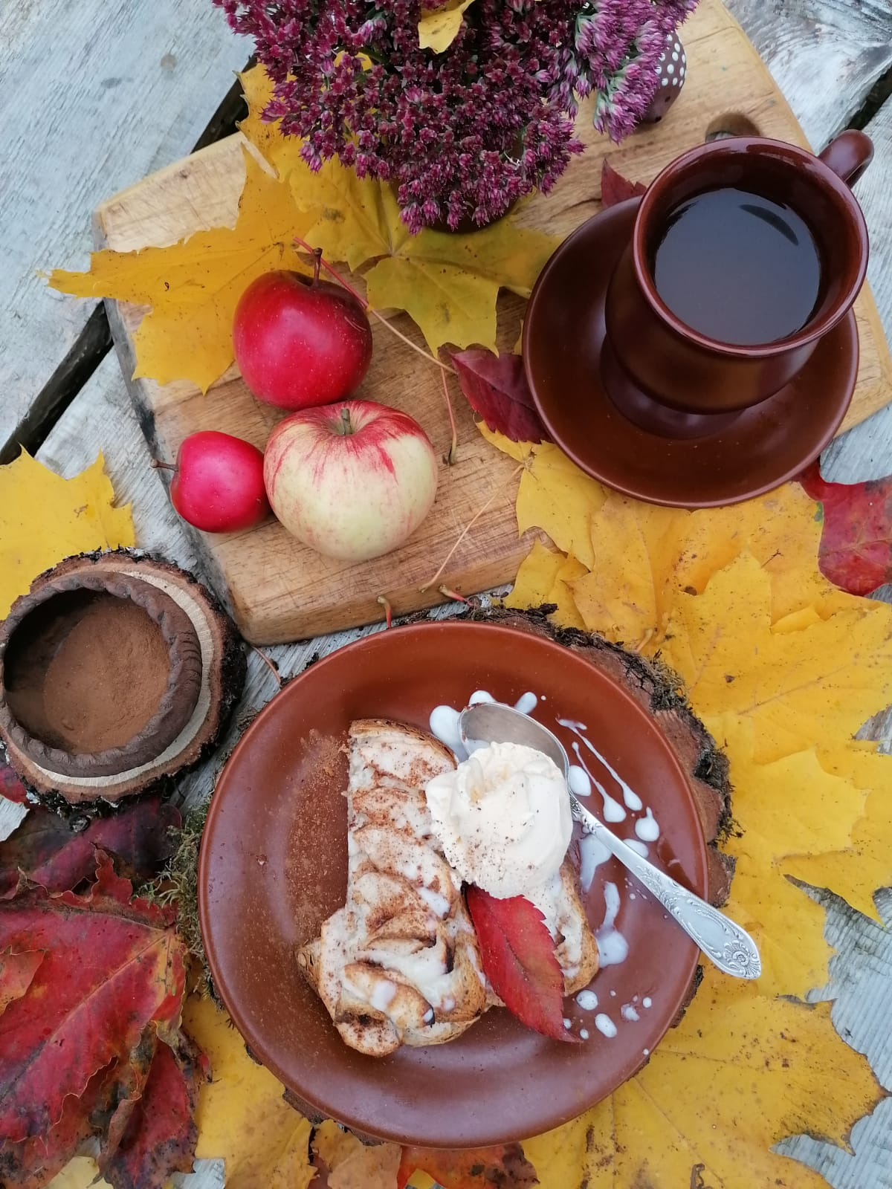
Quick apple ‘sandwiches’
Ingredients:
2 slices of white bread
1 apple
2 tablespoons of sour cream
sugar
1 teaspoon of cinnamon
How to make it: 1. Peel the apples and slice them thinly.
2. Layer the slices on bread.
3. Mix sugar, cream and cinnamon and pour on top of the apples.
4. Bake in the oven for 15-20 min, 200°.
5. Serve with a sprinkle of cinnamon.
Helpful video: https://youtu.be/a48uOVbaCbM

Slide 7
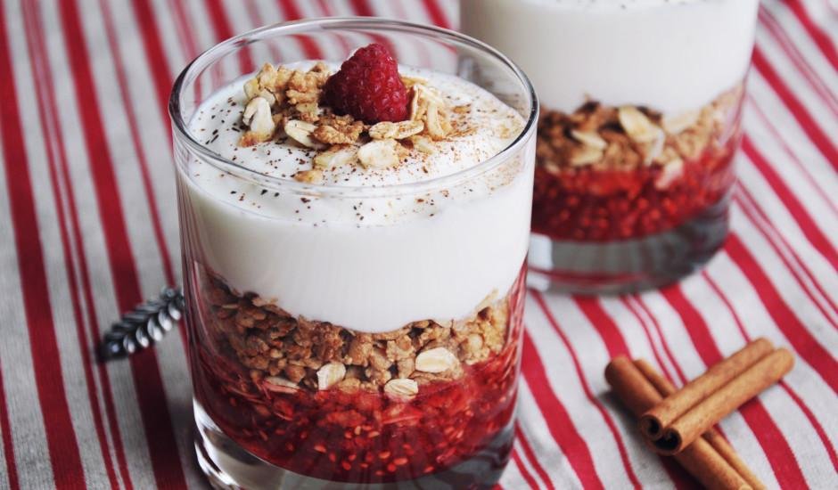
Oat flake and berry layers
Ingredients:
250 gr whipped cream
2 - 3 glasses of oat flakes
Sugar
Fresh berries or berry jam
Caramelize the oat flakes on a pan together with the sugar. Mix constantly not to burn them. When golden, place them aside to cool.
Prepare you whipped cream.
When oat flakes are cool, mix them together with the whipped cream.
In a glass or a bowl, layer the dessert - oat flakes, berries or jam etc.
Decorate with fresh berries.
Helpful video:
https://www.facebook.com/elviveikali/videos/karameliz%C4%93ts-auzu-p%C4%81rslu-k%C4%81rtojums/1058869180856273/

Slide 8
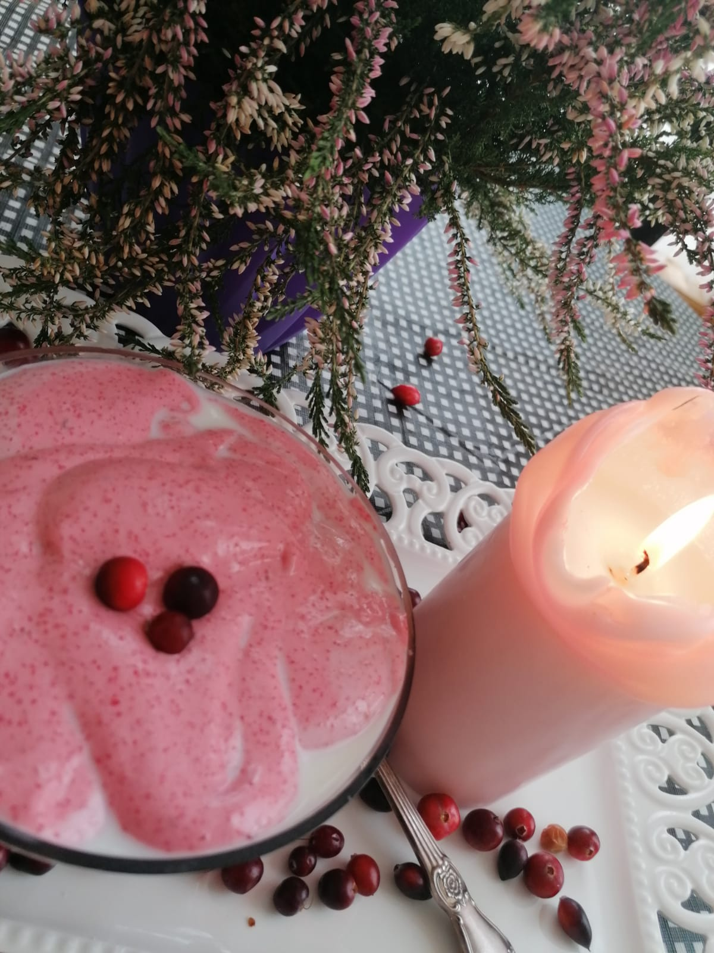
Debesmanna
Ingredients:
200 g cranberries
200 g sugar
100 g semolina
1 L water
Milk
How to make it:
Clean the cranberries. Cover them with a bit of warm water and blend them until you see an even mass.
Strain them through a fine sifter, add sugar and the rest of the water. Bring it to boil and then lower the heat. On small heat add semolina while constantly stirring and boil for 5 more minutes.
Let the newly formed mass cool to around 30ºC. Then whisk using a mixer it. Start with the slowest setting on the mixer and slowly increase the speed. The longer you whisk, the lighter, fluffier and tastier it will be.
Serve with cold milk. Pour milk in a bowl and carefully place little ‘islands’ of the mixture on it with a spoon.
Enjoy!
Helpful video: https://youtu.be/CnlKXAPeN0I

Slide 9
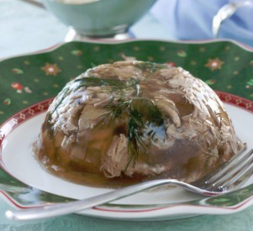
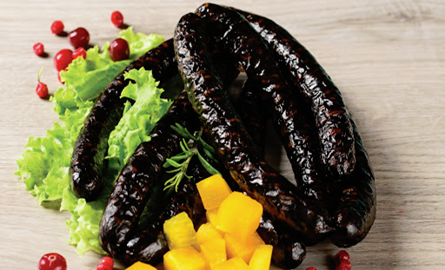
Estonian cuisine
Traditional Estonian cuisine has substantially been based on meat and potatoes, and on fish in coastal and lakeside areas, but now bears influence from many other cuisines, including a variety of international foods and dishes. The most typical foods in Estonia have been rye bread, pork, potatoes and dairy products. Estonian eating habits have historically been closely linked to the seasons.
Most known Estonian dishes from old times:
Meat jelly (brawn) Black pudding (blood pudding)

Slide 10
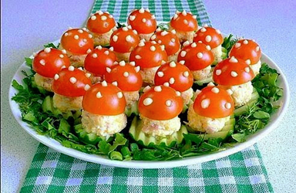
Stuffed egg appetizer - Mushrooms(amanita muscaria/ fly agaric)
Ingredients:
Eggs – 3 pcs
Ham – 120 g
Cheese – 100 g
Cherry tomatoes – 15 pcs
Fresh cucumber – 1 – 2 pcs
Mayonnaise – 1 – 2 tbsp
Dill, parsley, chives to decorate the dish
Cooking
Boil the eggs and grate them. Chop ham into small cubes and grate cheese. Mix all the components, add mayonnaise and form the mushroom stems from the mixture. Cut the tomatoes in half and scoop out the seeds. Slice the cucumbers, place the mushroom stems on the slices. Put the halved tomato on each stem and decorate with mayonnaise.

Slide 11
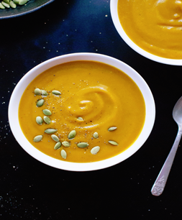
Vegetable soup light dish - Creamy pumpkin soup
Ingredients:
1 pumpkin (cut in half); 1 large onion (chopped)
2 potatoes (cubed) and 1 carrot (cubed)
1 liter chicken or vegetable broth
Roughly 120g butter + olive oil + cream
Cayenne pepper + other suitable spices
Cooking
Cut the pumpkin in half and place on a baking tray yellow side up. Roast in oven for roughly 30-40 minutes until soft and peel comes off easily. Meanwhile chop the onion and caramelize it in a pot with some olive oil, butter, salt and pepper. Cut roasted pumpkin in cubes and add them into the pot with the rest of butter. Put the lid on, turn the heat low and leave for 20 minutes. Add chopped potatoes and carrot; pour broth over the vegetables and cook until they are tender. Puree the soup and season to taste with salt, pepper and a pinch of Cayenne pepper. Add a cup of cream to the pot right before serving. Sprinkle some roasted pumpkin seeds on top of the soup when serving

Slide 12
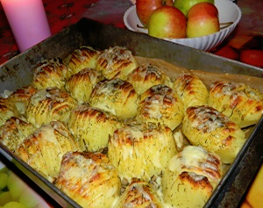
Potato main dish - Roasted potatoes
Ingredients:
Potatoes (rather larger) – 12 pcs
Butter or cooking oil
Grated cheese
Herbs (dill, parsley), sweet pepper powder or other suitable spices
Cooking
Grease the potatoes with butter or cooking oil and sprinkle dill (and other herbs / spices) on the potatoes
Place the potatoes onto oven pan, cut side up, and bake in 220 °C for 40-45 minutes (so that the top is nicely turned brown)
At the end of roasting add grated cheese onto the potatoes and roast some minutes

Slide 13
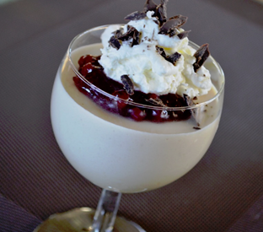
A twist on kamavaht dessert - Creamy coffee jelly
Ingredients:
1 glass of hot strong coffee
1 tbsp gelatin
5 tbsp water
250 g cream (at least 35 %)
3-4 tbsp sugar
Cooking
Make strong coffee and filter it. Melt gelatin in cold water, stir well. Mix the coffee and the gelatin. Place the liquid in a cool place and cool down to room temperature stirring occasionally. Whisk the cream with the sugar. Pour the cooled coffee-gelatin mixture into the whipped cream in a fine stream stirring well all the time. Let it freeze in a cold place. Serve with maple syrup, chopped nuts, whipped cream and berries

